Slide 1
5
Joint Probability Distributions
CHAPTER OUTLINE
5-1 Two or More Random Variables
5-1.1 Joint Probability Distributions
5-1.2 Marginal Probability Distributions
5-1.3 Conditional Probability Distributions
5-1.4 Independence
5-1.5 More Than Two Random Variables
5-2 Covariance and Correlation
5-3 Common Joint Distributions
5-3.1 Multinomial Probability Distribution
5-3.2 Bivariate Normal Distribution
5-4 Linear Functions of Random Variables
5-5 General Functions of Random Variables

Slide 2
Learning Objective for Chapter 5
After careful study of this chapter, you should be able to do the following:
Use joint probability mass functions and joint probability density functions to calculate probabilities.
Calculate marginal and conditional probability distributions from joint probability distributions.
Interpret and calculate covariances and correlations between random variables.
Use the multinomial distribution to determine probabilities.
Understand properties of a bivariate normal distribution and be able to draw contour plots for the probability density function.
Calculate means and variances for linear combinations of random variables, and calculate probabilities for linear combinations of normally distributed random variables.
Determine the distribution of a general function of a random variable.

Slide 3
Concept of Joint Probabilities
Some random variables are not independent of each other, i.e., they tend to be related.
Urban atmospheric ozone and airborne particulate matter tend to vary together.
Urban vehicle speeds and fuel consumption rates tend to vary inversely.
The length (X) of a injection-molded part might not be independent of the width (Y). Individual parts will vary due to random variation in materials and pressure.
A joint probability distribution will describe the behavior of several random variables, say, X and Y. The graph of the distribution is 3-dimensional: x, y, and f(x,y).

Slide 4
Example 5-1: Signal Bars
You use your cell phone to check your airline reservation. The airline system requires that you speak the name of your departure city to the voice recognition system.
Let Y denote the number of times that you have to state your departure city.
Let X denote the number of bars of signal strength on you cell phone.
Figure 5-1 Joint probability distribution of X and Y. The table cells are the probabilities. Observe that more bars relate to less repeating.

Slide 5
Joint Probability Mass Function Defined

Slide 6
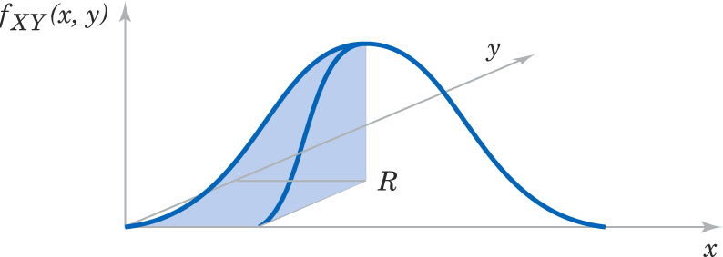
Joint Probability Density Function Defined
The joint probability density function for the continuous random variables X and Y, denotes as f_{XY}(x,y), satisfies the following properties:
Figure 5-2 Joint probability density function for the random variables X and Y. Probability that (X, Y) is in the region R is determined by the volume of f_{XY}(x,y) over the region R.

Slide 7
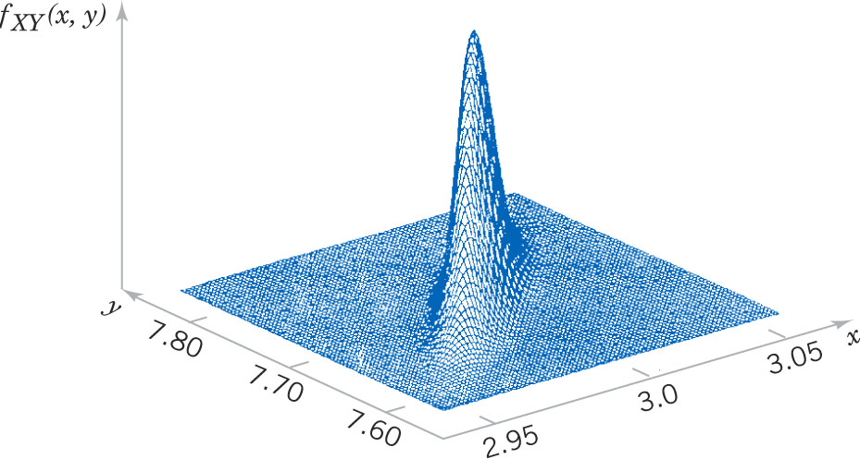
Joint Probability Mass Function Graph
Figure 5-3 Joint probability density function for the continuous random variables X and Y of different dimensions of an injection-molded part. Note the asymmetric, narrow ridge shape of the PDF – indicating that small values in the X dimension are more likely to occur when small values in the Y dimension occur.

Slide 8
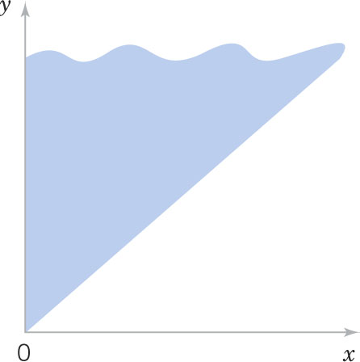
Example 5-2: Server Access Time-1
Let the random variable X denote the time (msec’s) until a computer server connects to your machine. Let Y denote the time until the server authorizes you as a valid user. X and Y measure the wait from a common starting point (x < y). The range of x and y are shown here.
Figure 5-4 The joint probability density function of X and Y is nonzero over the shaded region where x < y.

Slide 9
Example 5-2: Server Access Time-2
The joint probability density function is:
We verify that it integrates to 1 as follows:

Slide 10
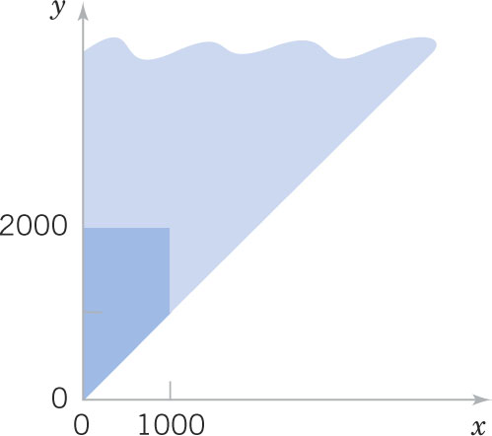
Example 5-2: Server Access Time-2
Now calculate a probability:
Figure 5-5 Region of integration for the probability that X < 1000 and Y < 2000 is darkly shaded.

Slide 11
Marginal Probability Distributions (discrete)
For a discrete joint PDF, there are marginal distributions for each random variable, formed by summing the joint PMF over the other variable.
Figure 5-6 From the prior example, the joint PMF is shown in green while the two marginal PMFs are shown in blue.

Slide 12
Marginal Probability Distributions (continuous)
Rather than summing a discrete joint PMF, we integrate a continuous joint PDF.
The marginal PDFs are used to make probability statements about one variable.
If the joint probability density function of random variables X and Y is f_{XY}(x,y), the marginal probability density functions of X and Y are:

Slide 13
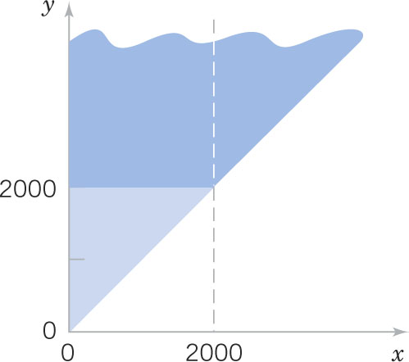
Example 5-4: Server Access Time-1
For the random variables times in Example 5-2, find the probability that Y exceeds 2000.
Integrate the joint PDF directly using the picture to determine the limits.

Slide 14
Example 5-4: Server Access Time-2
Alternatively, find the marginal PDF and then integrate that to find the desired probability.

Slide 15
Mean & Variance of a Marginal Distribution
Means E(X) and E(Y) are calculated from the discrete and continuous marginal distributions.

Slide 16
Mean & Variance for Example 5-1
E(X) = 2.35 V(X) = 6.15 – 2.35² = 6.15 – 5.52 = 0.6275
E(Y) = 2.49 V(Y) = 7.61 – 2.49² = 7.61 – 16.20 = 1.4099

Slide 17
Conditional Probability Distributions
From Example 5-1
P(Y=1|X=3) = 0.25/0.55 = 0.455
P(Y=2|X=3) = 0.20/0.55 = 0.364
P(Y=3|X=3) = 0.05/0.55 = 0.091
P(Y=4|X=3) = 0.05/0.55 = 0.091
Sum = 1.001
Note that there are 12 probabilities conditional on X, and 12 more probabilities conditional upon Y.

Slide 18
Conditional Probability Density Function Defined

Slide 19
Example 5-6: Conditional Probability-1
From Example 5-2, determine the conditional PDF for Y given X=x.

Slide 20
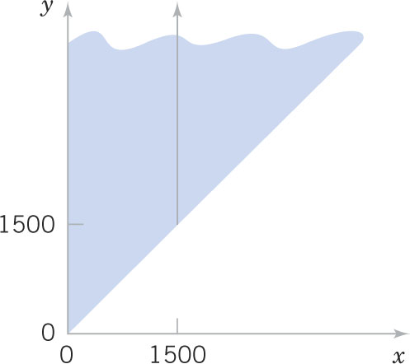
Example 5-6: Conditional Probability-2
Now find the probability that Y exceeds 2000 given that X=1500:
Figure 5-8 again The conditional PDF is nonzero on the solid line in the shaded region.

Slide 21
Example 5-7: Conditional Discrete PMFs
Conditional discrete PMFs can be shown as tables.

Slide 22
Mean & Variance of Conditional Random Variables
The conditional mean of Y given X = x, denoted as E(Y|x) or μ_{Y|x} is:
The conditional variance of Y given X = x, denoted as V(Y|x) or σ²_{Y|x} is:

Slide 23
Example 5-8: Conditional Mean & Variance
From Example 5-2 & 6, what is the conditional mean for Y given that x = 1500? Integrate by parts.
If the connect time is 1500 ms, then the expected time to be authorized is 2000 ms.

Slide 24
Example 5-9
For the discrete random variables in Exercise 5-1, what is the conditional mean of Y given X=1?
The mean number of attempts given one bar is 3.55 with variance of 0.7475.

Slide 25
Joint Random Variable Independence
Random variable independence means that knowledge of the values of X does not change any of the probabilities associated with the values of Y.
X and Y vary independently.
Dependence implies that the values of X are influenced by the values of Y.
Do you think that a person’s height and weight are independent?

Slide 26
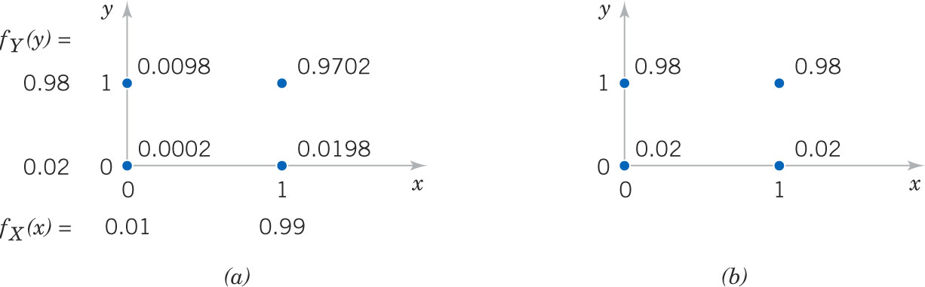
Exercise 5-10: Independent Random Variables
In a plastic molding operation, each part is classified as to whether it conforms to color and length specifications.
Figure 5-10(a) shows marginal & joint probabilities, f_{XY}(x, y) = f_{X}(x) * f_{Y}(y)
Figure 5-10(b) show the conditional probabilities, f_{Y|x}(y) = f_{Y}(y)

Slide 27
Properties of Independence
For random variables X and Y, if any one of the following properties is true, the others are also true. Then X and Y are independent.

Slide 28
Rectangular Range for (X, Y)
A rectangular range for X and Y is a necessary, but not sufficient, condition for the independence of the variables.
If the range of X and Y is not rectangular, then the range of one variable is limited by the value of the other variable.
If the range of X and Y is rectangular, then one of the properties of (5-7) must be demonstrated to prove independence.

Slide 29
Example 5-11: Independent Random Variables
Suppose the Example 5-2 is modified such that the joint PDF is:
Are X and Y independent? Is the product of the marginal PDFs equal the joint PDF? Yes by inspection.
Find this probability:

Slide 30
Example 5-12: Machined Dimensions
Let the random variables X and Y denote the lengths of 2 dimensions of a machined part. Assume that X and Y are independent and normally distributed. Find the desired probability.

Slide 31
Example 5-13: More Than Two Random Variables
Many dimensions of a machined part are routinely measured during production. Let the random variables X₁, X₂, X₃ and X₄ denote the lengths of four dimensions of a part.
What we have learned about joint, marginal and conditional PDFs in two variables extends to many (p) random variables.

Slide 32
Joint Probability Density Function Redefined
The joint probability density function for the continuous random variables X₁, X₂, X₃, …X_{p}, denoted as
satisfies the following properties:

Slide 33
Example 5-14: Component Lifetimes
In an electronic assembly, let X₁, X₂, X₃, X₄ denote the lifetimes of 4 components in hours. The joint PDF is:
What is the probability that the device operates more than 1000 hours?
The joint PDF is a product of exponential PDFs.
P(X₁ > 1000, X₂ > 1000, X₃ > 1000, X₄ > 1000)
= e^{-1-2-1.5-3} = e^{-7.5} = 0.00055

Slide 34
Example 5-15: Probability as a Ratio of Volumes
Suppose the joint PDF of the continuous random variables X and Y is constant over the region x² + y² =4. The graph is a round cake with radius of 2 and height of 1/4π.
A cake round of radius 1 is cut from the center of the cake, the region x² + y² =1.
What is the probability that a randomly selected bit of cake came from the center round?
Volume of the cake is 1. The volume of the round is π *1/4π = ¼. The desired probability is ¼.

Slide 35
Marginal Probability Density Function

Slide 36
Mean & Variance of a Joint PDF
The mean and variance of X_{i} can be determined from either the marginal PDF, or the joint PDF as follows:

Slide 37
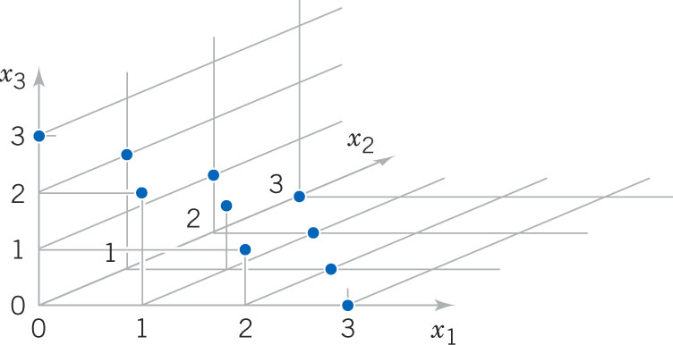
Example 5-16
There are 10 points in this discrete joint PDF.
Note that
x₁+x₂+x₃ = 3
List the marginal PDF of X₂

Slide 38
Reduced Dimensionality

Slide 39
Conditional Probability Distributions
Conditional probability distributions can be developed for multiple random variables by extension of the ideas used for two random variables.
Suppose p = 5 and we wish to find the distribution conditional on X₄ and X₅.

Slide 40
Independence with Multiple Variables
The concept of independence can be extended to multiple variables.

Slide 41
Example 5-17
In Chapter 3, we showed that a negative binomial random variable with parameters p and r can be represented as a sum of r geometric random variables X₁, X₂,…, X_{r} , each with parameter p.
Because the binomial trials are independent, X₁, X₂,…, X_{r} are independent random variables.

Slide 42
Example 5-18: Layer Thickness
Suppose X₁,X₂,X₃ represent the thickness in μm of a substrate, an active layer and a coating layer of a chemical product. Assume that these variables are independent and normally distributed with parameters and specified limits as tabled.
What proportion of the product meets all specifications?
Answer: 0.7783, 3 layer product.
Which one of the three thicknesses has the least probability of meeting specs?
Answer: Layer 3 has least prob.

Slide 43
Covariance
Covariance is a measure of the relationship between two random variables.
First, we need to describe the expected value of a function of two random variables. Let h(X, Y) denote the function of interest.

Slide 44
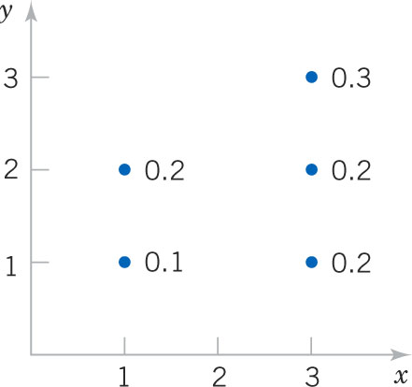
Example 5-19: E(Function of 2 Random Variables)
Task: Calculate E[(X-μ_{X})(Y-μ_{Y})] = covariance
Figure 5-12 Discrete joint distribution of X and Y.

Slide 45
Covariance Defined

Slide 46
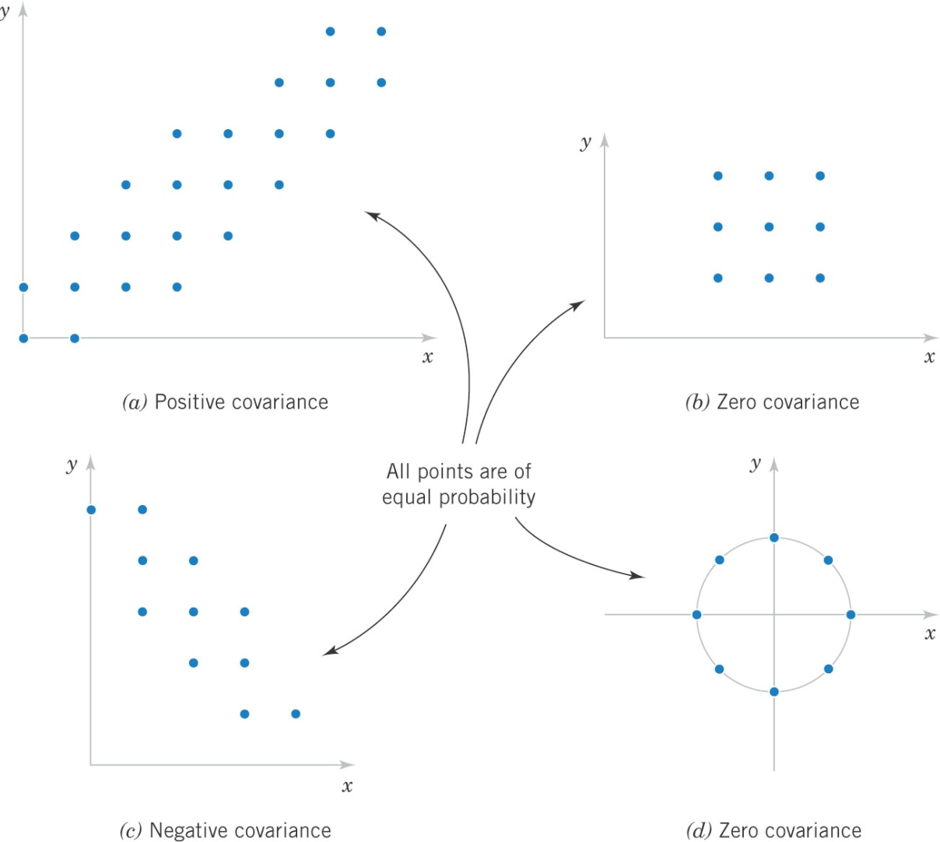
Covariance and Scatter Patterns
Figure 5-13 Joint probability distributions and the sign of cov(X, Y). Note that covariance is a measure of linear relationship. Variables with non-zero covariance are correlated.

Slide 47
Example 5-20: Intuitive Covariance
The probability distribution of Example 5-1 is shown.
By inspection, note that the larger probabilities occur as X and Y move in opposite directions. This indicates a negative covariance.

Slide 48
Correlation (ρ = rho)

Slide 49
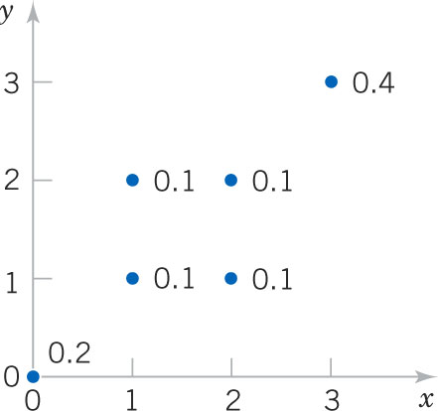
Example 5-21: Covariance & Correlation
Determine the covariance and correlation.
Figure 5-14 Discrete joint distribution, f(x, y).

Slide 50
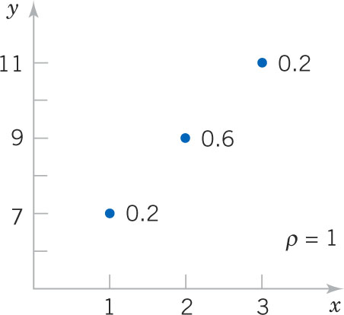
Example 5-21
Calculate the correlation.
Figure 5-15 Discrete joint distribution. Steepness of line connecting points is immaterial.

Slide 51
Independence Implies ρ = 0
If X and Y are independent random variables,
σ_{XY} = ρ_{XY} = 0 (5-17)
ρ_{XY} = 0 is necessary, but not a sufficient condition for independence.
Figure 5-13d (x, y plots as a circle) provides an example.
Figure 5-13b (x, y plots as a square) indicates independence, but a non-rectangular pattern would indicate dependence.

Slide 52
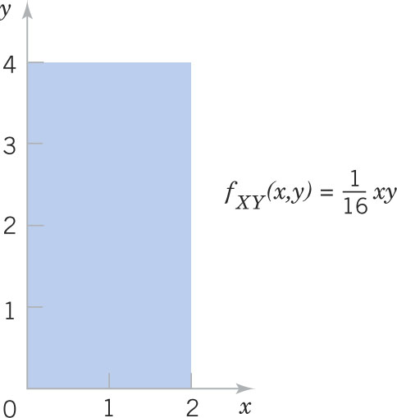
Example 5-23: Independence Implies Zero Covariance
Figure 5-15 A planar joint distribution.

Slide 53
Common Joint Distributions
There are two common joint distributions
Multinomial probability distribution (discrete), an extension of the binomial distribution
Bivariate normal probability distribution (continuous), a two-variable extension of the normal distribution. Although they exist, we do not deal with more than two random variables.
There are many lesser known and custom joint probability distributions as you have already seen.

Slide 54
Multinomial Probability Distribution
Suppose a random experiment consists of a series of n trials. Assume that:
The outcome of each trial can be classifies into one of k classes.
The probability of a trial resulting in one of the k outcomes is constant, denoted as p₁, p₂, …, p_{k}.
The trials are independent.
The random variables X₁, X₂,…, X_{k} denote the number of outcomes in each class and have a multinomial distribution and probability mass function:

Slide 55
Example 5-24: Digital Channel
Of the 20 bits received over a digital channel, 14 are of excellent quality, 3 are good, 2 are fair, 1 is poor. The sequence received was EEEEEEEEEEEEEEGGGFFP.
The probability of that sequence is 0.6¹⁴0.3³0.08²0.02¹ = 2.708*10⁻⁹
However, the number of different ways of receiving those bits is a lot!
The combined result is a multinomial distribution.

Slide 56
Example 5-25: Digital Channel
Refer again to the prior Example 5-24.
What is the probability that 12 bits are E, 6 bits are G, 2 are F, and 0 are P?

Slide 57
Multinomial Means and Variances
The marginal distributions of the multinomial are binomial.
If X₁, X₂,…, X_{k} have a multinomial distribution, the marginal probability distributions of X_{i} is binomial with:
E(X_{i}) = np_{i} and V(X_{i}) = np_{i}(1-p_{i}) (5-19)

Slide 58
Example 5-26: Marginal Probability Distributions
Refer again to the prior Example 5-25.
The classes are now {G}, {F}, and {E, P}.
Now the multinomial changes to:

Slide 59
Example 5-27: Bivariate Normal Distribution
Earlier, we discussed the two dimensions of an injection-molded part as two random variables (X and Y). Let each dimension be modeled as a normal random variable. Since the dimensions are from the same part, they are typically not independent and hence correlated.
Now we have five parameters to describe the bivariate normal distribution:
μ_{X}, σ_{X}, μ_{Y}, σ_{Y}, ρ_{XY}

Slide 60
Bivariate Normal Distribution Defined

Slide 61
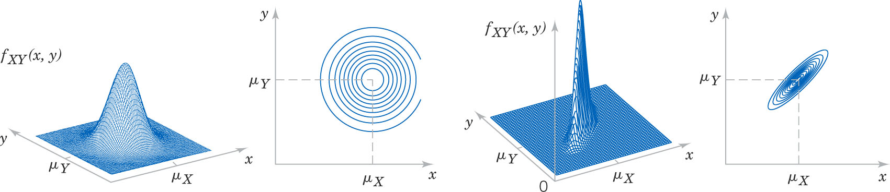
Role of Correlation
Figure 5-17 These illustrations show the shapes and contour lines of two bivariate normal distributions. The left distribution has independent X, Y random variables (ρ = 0). The right distribution has dependent X, Y random variables with positive correlation (ρ > 0, actually 0.9). The center of the contour ellipses is the point (μ_{X}, μ_{Y}).

Slide 62
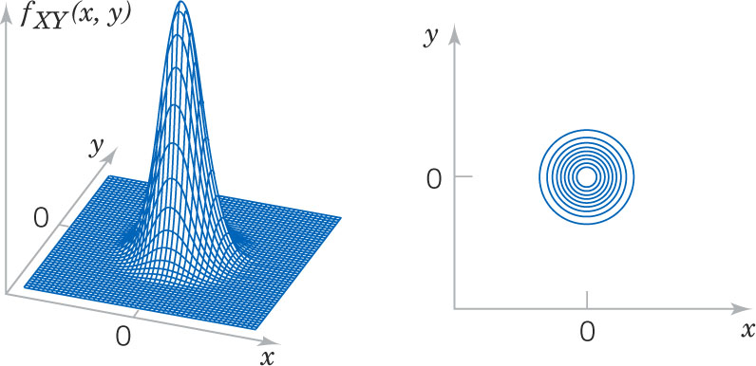
Example 5-28: Standard Bivariate Normal Distribution
Figure 5-18 This is a standard bivariate normal because its means are zero, its standard deviations are one, and its correlation is zero since X and Y are independent. The density function is:

Slide 63
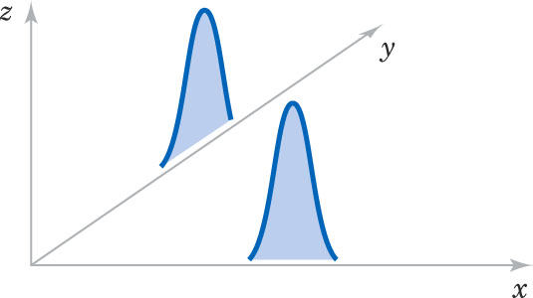
Marginal Distributions of the Bivariate Normal
If X and Y have a bivariate normal distribution with joint probability density function f_{XY}(x,y;σ_{X},σ_{Y},μ_{X},μ_{Y},ρ), the marginal probability distributions of X and Y are normal with means μ_{X} and μ_{Y} and σ_{X} and σ_{Y}, respectively. (5-21)
Figure 5-19 The marginal probability density functions of a bivariate normal distribution are simply projections of the joint onto each of the axis planes. Note that the correlation (ρ) has no effect on the marginal distributions.

Slide 64
Conditional Distributions of the Joint Normal
If X and Y have a bivariate normal distribution with joint probability density f_{XY}(x,y;σ_{X},σ_{Y},μ_{X},μ_{Y},ρ), the conditional probability distribution of Y given X = x is normal with mean and variance as follows:

Slide 65
Correlation of Bivariate Normal Random Variables
If X and Y have a bivariate normal distribution with joint probability density function f_{XY}(x,y;σ_{X},σ_{Y},μ_{X},μ_{Y},ρ), the correlation between X and Y is ρ. (5-22)

Slide 66
Bivariate Normal Correlation & Independence
In general, zero correlation does not imply independence.
But in the special case that X and Y have a bivariate normal distribution, if ρ = 0, then X and Y are independent. (5-23)

Slide 67
Example 5-29: Injection-Molded Part
The injection- molded part dimensions has parameters as tabled and is graphed as shown.
The probability of X and Y being within limits is the volume within the PDF between the limit values.
This volume is determined by numerical integration – beyond the scope of this text.
Figure 5-3

Slide 68
Linear Functions of Random Variables
A function of random variables is itself a random variable.
A function of random variables can be formed by either linear or nonlinear relationships. We limit our discussion here to linear functions.
Given random variables X₁, X₂,…,X_{p} and constants c₁, c₂, …, c_{p} Y= c₁X₁ + c₂X₂ + … + c_{p}X_{p} (5-24) is a linear combination of X₁, X₂,…,X_{p}.

Slide 69
Mean & Variance of a Linear Function
Let Y= c₁X₁ + c₂X₂ + … + c_{p}X_{p} and use Equation 5-10:

Slide 70
Example 5-30: Negative Binomial Distribution
Let X_{i} be a geometric random variable with parameter p with μ = 1/p and σ² = (1-p)/p²
Let Y = X₁ + X₂ +…+X_{r}, a linear combination of r independent geometric random variables.
Then Y is a negative binomial random variable with μ = r/p and σ² = r(1-p)/p² by Equations 5-25 and 5-27.
Thus, a negative binomial random variable is a sum of r identically distributed and independent geometric random variables.

Slide 71
Example 5-31: Error Propagation
A semiconductor product consists of three layers. The variances of the thickness of each layer is 25, 40 and 30 nm. What is the variance of the finished product?
Answer:

Slide 72
Mean & Variance of an Average

Slide 73
Reproductive Property of the Normal Distribution

Slide 74
Example 5-32: Linear Function of Independent Normals
Let the random variables X₁ and X₂ denote the independent length and width of a rectangular manufactured part. Their parameters are shown in the table.
What is the probability that the perimeter exceeds 14.5 cm?

Slide 75
Example 5-33: Beverage Volume
Soft drink cans are filled by an automated filling machine. The mean fill volume is 12.1 fluid ounces, and the standard deviation is 0.1 fl oz. Assume that the fill volumes are independent, normal random variables. What is the probability that the average volume of 10 cans is less than 12 fl oz?

Slide 76
General Functions of Random Variables
A linear combination is not the only way that we can form a new random variable (Y) from one or more of random variables (X_{i}) that we already know. We will focus on single variables, i.e., Y = h(X), the transform function.
The transform function must be monotone:
Each value of x produces exactly one value of y.
Each value of y translates to only one value of x.
This methodology produces the probability mass or density function of Y from the function of X.

Slide 77
General Function of a Discrete Random Variable
Suppose that X is a discrete random variable with probability distribution f_{X}(x). Let Y = h(X) define a one-to-one transformation between the values of X and Y so that the equation y = h(x) can be solved uniquely for x in terms of y. Let this solution be x = u(y), the inverse transform function. Then the probability mass function of the random variable Y is
f_{Y}(y) = f_{X}[u(y)] (5-30)

Slide 78
Example 5-34: Function of a Discrete Random Variable
Let X be a geometric random variable with PMF: f_{X}(x) = p(1-p)^{x-1} for x = 1, 2, …
Find the probability distribution of Y = X².
Solution:
Since X > 0, the transformation is one-to-one.
The inverse transform function is X = sqrt(Y).
f_{Y}(y) = p(1-p)^{sqrt(y)-1} for y = 1, 4, 9, 16,…

Slide 79
General Function of a Continuous Random Variable
Suppose that X is a continuous random variable with probability distribution f_{X}(x). Let Y = h(X) define a one-to-one transformation between the values of X and Y so that the equation y = h(x) can be solved uniquely for x in terms of y. Let this solution be x = u(y), the inverse transform function. Then the probability density function of the random variable Y is
f_{Y}(y) = f_{X}[u(y)]∙|J| (5-31) where J = u’(y) is called the Jacobian of the transformation and the absolute value is used.

Slide 80
Example 5-35: Function of a Continuous Random Variable
Let X be a continuous random variable with probability distribution:
Find the probability distribution of Y = h(X) = 2X + 4

Slide 81
Important Terms & Concepts for Chapter 5
Bivariate distribution
Bivariate normal distribution
Conditional mean
Conditional probability density function
Conditional probability mass function
Conditional variance
Contour plots
Correlation
Covariance
Error propagation
General functions of random variables
Independence
Joint probability density function
Joint probability mass function
Linear functions of random variables
Marginal probability distribution
Multinomial distribution
Reproductive property of the normal distribution

